Slide 1

Symmetric block Ciphers & Cipher Block Chaining
By: Raghav Saini (200020203027)

Slide 2
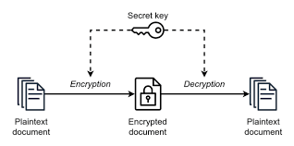
Symmetric Encryption
Single Common key for Decryption
Sender and reciever share a common key

Slide 3
How It Works
plaintext - original message
Encipher (encrypt) - converting plaintext to ciphertext
Sending that enciphered text to the reciever
key – Secret Key used in cipher known only to sender/receiver
Decipher (decrypt) - recovering plaintext from ciphertext
Getting PlainText from cypher text using the secret Key.

Slide 4
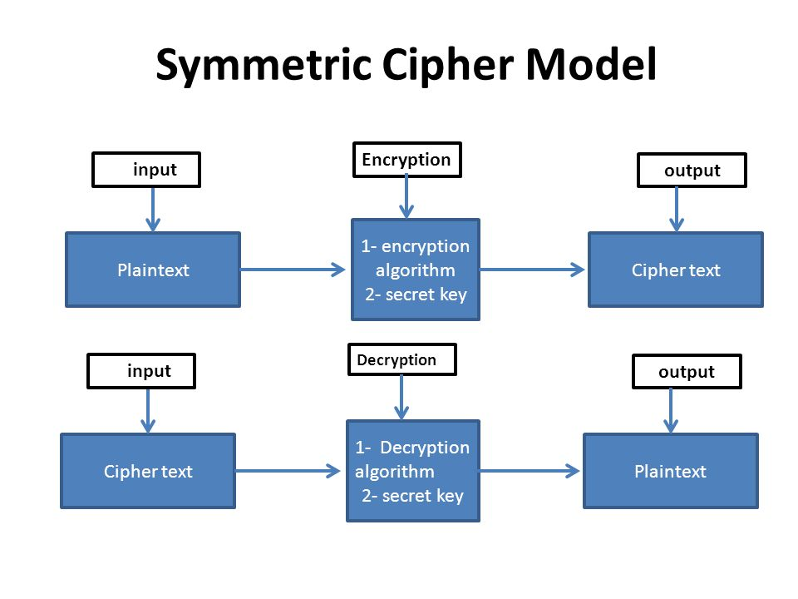
Symmetric Cipher Model

Slide 5

Cipher Block Chaining

Slide 6
What is Cipher Block Chaining
Its a mode of operation of Symmetric block cipher
A sequence of bits are encrypted as a single unit, or block, with a cipher key applied to the entire block.

Slide 7
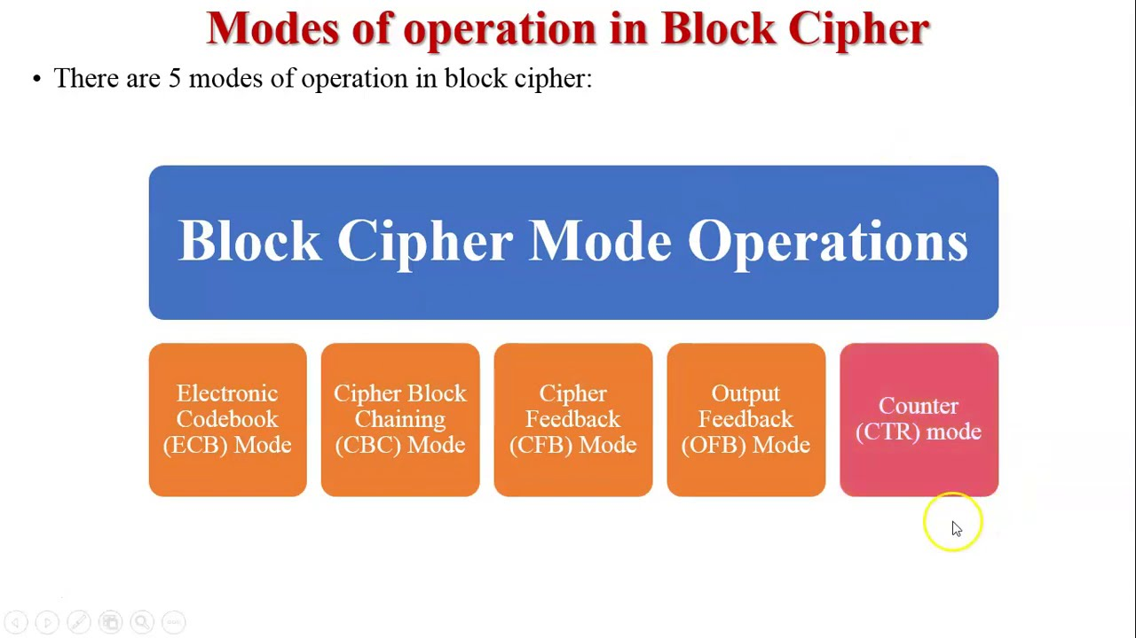

Slide 8
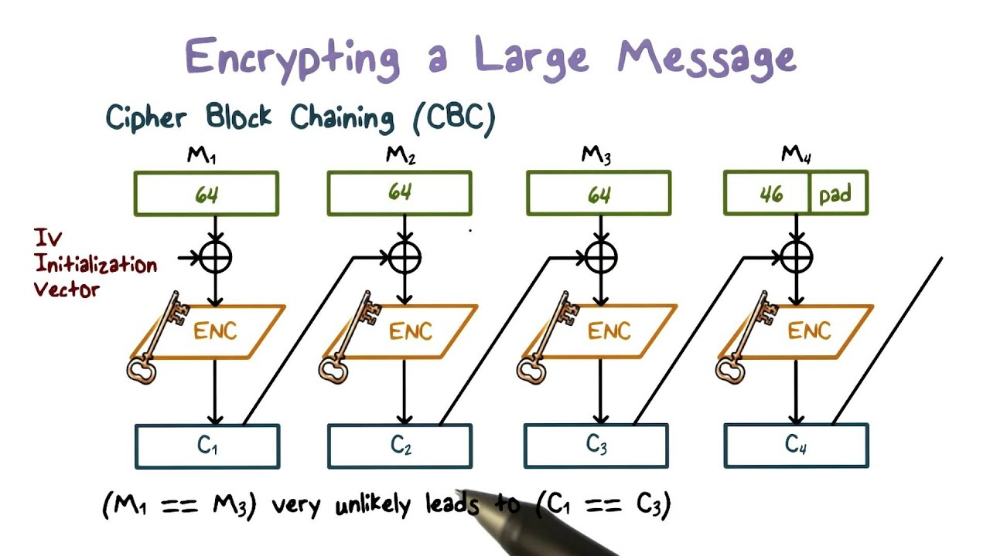

Slide 9

THANK YOU.

